Slide 1
Bring in F# via NuGet
Andrew Chaa, Huddle

Slide 2

Why?

Slide 3
F# is great for specialist areas and an excellent choice for enterprise development
(From F# for fun and profit)
http://fsharpforfunandprofit.com/why-use-fsharp/

Slide 4

Why NuGet?

Slide 5
Easiest and biggest dependency management in .NET

Slide 6
Write in F#. Use for C#

Slide 7
Mitigate the risk or concerns of introducing a new language to the project and to the team

Slide 8
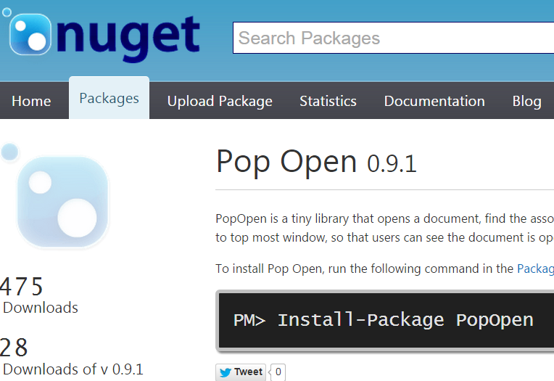
Someone (?) downloads it!
https://www.nuget.org/packages/PopOpen/

Slide 9
Briefly, PopOpen does
Launch an application that is associated with the file extension
Search through processes and find the one that locks the file
Or grab the process that returns from the launch
Push it to the foreground through all windows

Slide 10

Things I learned

Slide 11
logging
Log the details for the consumer project

Slide 12
let mutable Log = fun s -> printfn "%s" s
let OpenD ((file: string), (logFn: Action<string>)) =
Log <- fun s -> logFn.Invoke(s)
OpenInternal Start WaitSeconds FindLockHandle
FindProcessHandle file

Slide 13
Mind C#
let mutable Log = fun s -> printfn "%s" s
let OpenD ((file: string), (logFn: Action<string>)) =
Log <- fun s -> logFn.Invoke(s)
OpenInternal Start WaitSeconds FindLockHandle
FindProcessHandle file

